Slide 1
APARTMENT MANAGMENT SYSTEM
Group-19 (Apartment management system)

Slide 2
Group Members
Eray Gül
Ahmet Özcan
Baran Açıkgöz
Buğra Toker
Ömer Aslan

Slide 3
What is our goal?

Slide 4
What did we do for our goal?

Slide 5
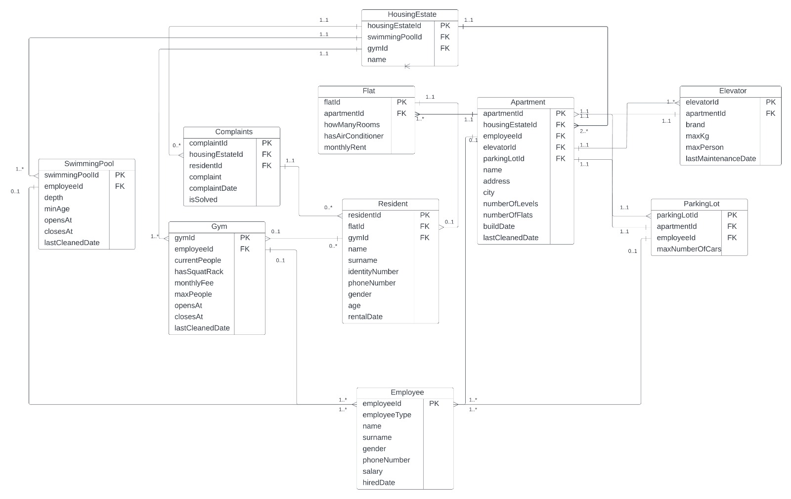
E-R Diagram

Slide 7
Other queries we used

Slide 8
A way to add a new APARTMENT
INSERT INTO
Apartment(ApartmentId, HousingEstateId, EmployeeId, ElevatorId, ParkingLotId, Name, Address, City, NumberOfLevels, NumberOfFlats, BuildDate,LastCleanedDate)
VALUES
(ApartmentId, HousingEstateId, EmployeeId, ElevatorId, ParkingLotId, Name, Address, City, NumberOfLevels, NumberOfFlats, BuildDate, LastCleanedDate)

Slide 9
A way to change the LAST MAINTENANCE DATE for ELEVATOR
UPDATE Elevator
SET
LastMaintenanceDate = [newLastMaintenanceDate]
WHERE
ElevatorId = ChosenElevatorId;

Slide 10
List all COMPLAINTS WHICH ARE NOT SOLVED
SELECT *
FROM Complaints
WHERE
ComplaintIsSolved = FALSE;

Slide 11
A way to remove employee from the system
DELETE FROM Employee e
WHERE
e.EmployeeId = 1008;

Slide 12
LIST ALL APARTMENTS AND HOW MANY COMPLAINTS ARE AT EACH
SELECT a.ApartmentID, COUNT(c.ComplaintId) AS ComplaintsCount
FROM Apartment a, HousingEstate h, Complaints c
WHERE
c.ComplaintHousingEstateId = h.HousingEstateId AND
h.HousingEstateId = a.HousingEstateId
GROUP BY a.ApartmentId;

Slide 13
Questions

